Slide 1

AP Chemistry Expectations

Slide 2
AP Chemistry
Tips for Success:
Do the homework. I deleted all the fluff.
Read and understand the notes.
Read the book.
Work half as hard as I do.

Slide 3
Classroom Procedures
  Beginning of Class: Before Tardy Bell
  Students will enter classroom quietly.
  Students will turn in homework to
  The homework box. It’s late after the
  tardy bell.
  Students needing make-up work will get it
  From the Make Up Folder.
  Students will look to board for class agenda.
  Students will perform warm up activity.

Slide 4
Classroom Procedures
  Class Time:
  Students will minimize distracting noises.
  Students will stay conscious.
  Students will stay seated. Do not
  move about the room during note
  taking.
  Students finishing early will study or read approved materials.
  End of Class:
  Students will pick up materials and seating area.
  Students will wait to be dismissed by teacher.
  Students will leave quickly and quietly.

Slide 5
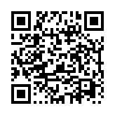
Chemistry AP Website
website information
http://www.myteacherpages.com/webpages/apchem
Password: pvnrt
Notes
Labs

Slide 6
Media
You Tube Channel: 100patoms , open to the public. Video taped lectures.

Slide 7
Packet o’ Paper
1. Find and keep all reference materials.
2. Pay attention to the calendar. I try really hard to follow it. I reserve the right to totally change it.
Notice you are responsible for the material in chapters 1 and 2. Really.

Slide 8
Laboratory Procedures
When I flick the lights twice, be silent, do not move, and look for me.
When the goggle cabinet is open take them. Return them to the cabinet at the end of lab.
Clean up the lab area before class ends.
Your last task is to wash your hands!!!
YOU MUST WEAR CLOSED TOED SHOES ON LAB DAY.

Slide 9

You’ll need to remember this soon.
Sig Fig Song
Sig Figs are like family.

Slide 10
Make Up Work
The student:
must pick up assignments from the make up folder. Check the calendar or another student for info. Ask me (before or after class) if there are questions.
Has one day plus the number of days absent to complete the assignments.
Must take the test upon return if absent only the day of the test or the day of review.

Slide 11

Get used to the cat theme.

Slide 12
Required Materials
Accordion Folder with 12-15 sections
Closed toed shoes on lab days
Latex or nitrile gloves for lab safety
1inch 3-ring binder to keep your lab copies
The usual stuff

Slide 13

Grades
60% Major: Tests
25% Lab: Mini lab 1x, Major Labs 2x
15% and Daily: Homework and daily class work

Slide 14
Tutoring Days
  Tutoring on Monday and Wednesday and every other day that you show up.
  Wait , not on Friday, Happy Hour.

Slide 15
You’ll need to know this too.
Dimensional Analysis Refresher

Slide 16
Contact Information
pamela.adams@cfisd.net
Conference Period- 4th.
Email is the best way to contact me.
www.myteacherpages.com/webpages/apchem

Slide 17
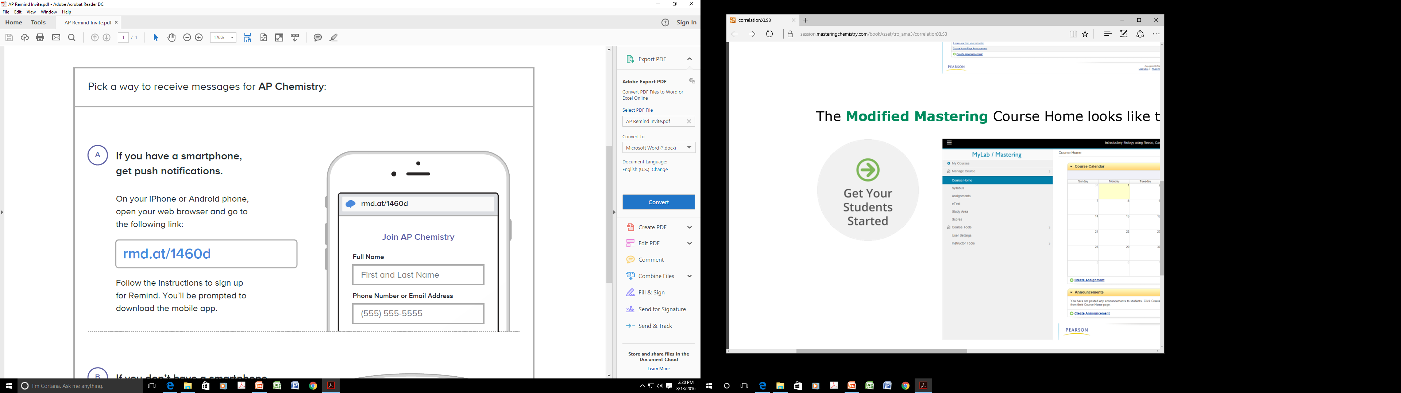
Stay informed.
Remind

Slide 18
Same as Last Year
District Redo Policy- You may make up ONE major grade per six weeks and ONE daily grade.
Science Late Policy- you may turn in an assignment one day late without penalty. It will not be accepted on the second day.

Slide 19
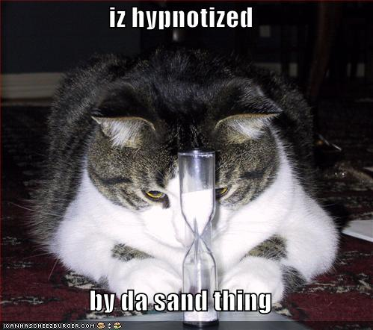
Done !!!

Slide 20
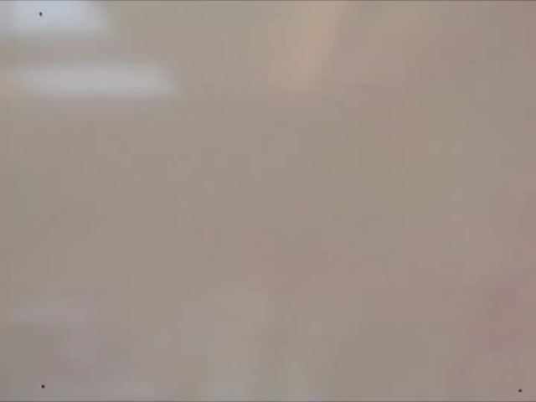
Dimensional Analysis
https://www.youtube.com/watch?v=XKCZn5MLKvk
Dimensional Analysis is your friend.

